Slide 1
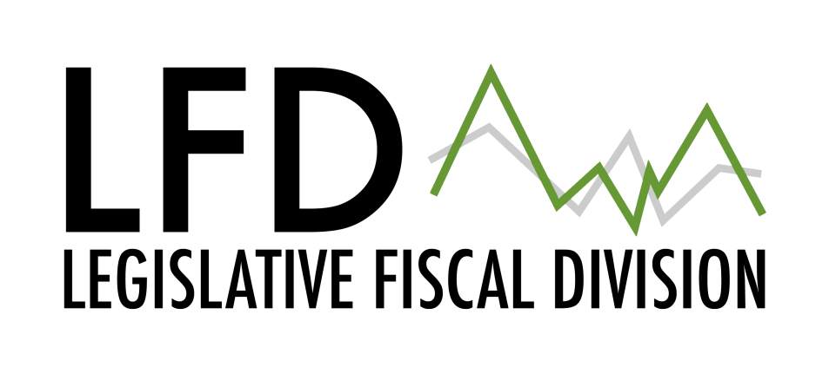
Funds at the District Level
Characteristics, revenue sources and restrictions

Slide 2
Purpose of Presentation
Characteristics of Budgeted funds
  State supported
  Non-state supported
Brief overview of Non-budgeted
  Special Purpose
  Internal Service Funds

Slide 3
Budgeted Funds
Eleven funds
  General Fund, Adult Education, Building Reserve, Bus Depreciation, Debt Service, Flexibility, Non-operating, Retirement, Transportation, Technology and Tuition
Statutory Characteristics
  When the fund must be established
  How the budget for the fund is determined
  Fund specific net levy requirement calculations
  State support of the fund
  Limitations and restrictions

Slide 4
General Fund
Purpose: The General Fund (GF) is for the purpose of financing general maintenance and operational costs of a district not financed by other funds. (20-9-201, MCA)
Budgeting: Statute defines the minimum GF budget (or BASE budget) and the maximum GF budget for each district. (20-9-306). Trustees must adopt a budget that is at least equal to the BASE budget. The trustees also have the option of budgeting up to the maximum amount or the previous year’s GF budget – whichever is greater. (20-9-308, MCA)
State Revenue: Direct State Aid (ANB & Basic Entitlement), Quality Educator Funds, Indian Education funds, American Indian Achievement Gap funds, At-Risk Payment, Guaranteed Tax Base Aid, Special Education Payments
Local Revenue: Taxes levied on property within the school district and fund balance re-appropriated.
Transferability: Transfers from the general fund can only occur for the following purposes:
  To establish or maintain a compensated absence liability fund. The transfer must be within the adopted general fund budget. (20-9-512,MCA)
  To fund the litigation reserve fund when active litigation exists. The transfer must be done at the end of the school fiscal year, be within the adopted general fund budget and be transferred back to the general fund at the conclusion of the litigation. (20-9-515, MCA)
  To the interlocal agreement fund when the district is the prime agency of the agreement. Transfer is completed by a trustee resolution and must be used to finance the operational cost of the interlocal agreement. (20-9-703,MCA)
Transfers to the general fund can only occur for the following purposes:
  Excess balance of the compensated absence liability fund. (ARM 10.10.320)
  Remaining funds in the litigation reserve fund at the conclusion of litigation (20-9-515,MCA)
  Cash balance excess, as defined in statute, of the lease or rental agreement fund must be transferred to the general fund. (20-5-509,MCA)
Notes:
Add restrictions

Slide 5
Adult Education
Purpose: The fund is established by districts to account for financing adult education activities. Districts have the option to establish such programs
Budgeting: Trustees must establish a budget that is sufficient to cover all costs of operations of the adult education fund.
Local Revenue: District-wide permissive levy for adult education and any tuition and fees charged for the use of equipment and materials.
Transferability: Adult Education funds can be transferred to any budgeted fund, except the general fund. A public hearing must occur. Any tax dollars transferred must be used for the same purpose as the original levy.
Restrictions: Operating reserve is limited to 35% of the budget for the following school year.

Slide 6
Building Reserve Fund
Purpose: The Building Reserve Fund is for the purpose of financing voter approved building or construction projects funded with district levies.
Budgeting: The trustees establish a budget at an amount equal to the total amount approved by the voters divided by the specified number of years of the levy authorization.
Local Revenue: District-wide voter approved levy for building.
Transferability: Building Reserve funds can be transferred to any budgeted fund, except the general fund. A public hearing must occur. Any tax dollars transferred must be used for the same purpose as the original levy.

Slide 7
Building Reserve Fund
Purpose: The Building Reserve Fund is for the purpose of financing voter approved building or construction projects funded with district levies. (20-9-503, MCA)
Budgeting: The trustees establish a budget at an amount equal to the total amount approved by the voters divided by the specified number of years of the levy authorization.
Local Revenue: District-wide levy for building.
Transferability: Building Reserve funds can be transferred to any budgeted fund, except the general fund. A public hearing must occur. Any tax dollars transferred must be used for the same purpose as the original levy.

Slide 8
Bus Depreciation
Purpose: This fund is for the purpose of financing the replacement of buses and two-way radio equipment owned by a school district. Fund may be used to replace route buses or athletics/activities buses and to purchase additional yellow school buses for routes. However, the Bus Depreciation Fund MAY NOT be used to purchase additional athletics/activities buses. (20-10-147, MCA)
Budgeting: The trustees can adopt a budget that does not exceed 20% of cost of a new bus or two-way radio.
Local Revenue: District wide levy – established based on budget.
Transferability: Bus depreciation funds can be transferred to any budgeted fund, except the general fund. A public hearing must occur.
Note: SB 329 of the 2011 session – eliminated the requirement for the district to seek voter approval to sell all of the district buses and transfer those funds to any budgeted fund.

Slide 9
Debt Service
Purpose: This fund is required by statute for any district that has outstanding general obligations bonds. This fund is for paying interest and principal on outstanding bonds and special improvement district (SID) assessments. This fund is also used to account for the proceeds of bonds sold for various purposes, including building or remodeling of district facilities, buying or leasing buses, or funding judgments against the district. (20-9-438,MCA)
Budgeting: Trustees must budget for bond interest and principle payments, SID assessments, and a limited operating reserve to cash flow between school years. Excess funds, after the operating reserve, are to be re-appropriated for property tax reduction.
State Revenue: School facility entitlements.
Local Revenue: Levy revenue for debt service – calculated as the annual payment required to fund principle and interest on bonds.
Federal Revenue: Impact Aid
Transferability: Transfers of debt service funds may only occur when the fund is closed. Those funds can be transferred to the general fund, building reserve fund or technology funds. If federal impact aid was transferred into the fund, those funds must be returned to the federal impact aid fund.

Slide 10
Flexibility Fund
Purpose: The flexibility fund is available for the purpose of paying salaries, operating expenses, building expenses, and purchasing supplies and equipment. (20-9-543, MCA)
Budgeting: The trustees establish the budget amount. Statute does not prescribe how this is accomplished.
State Revenue: Statute allows the legislature to appropriate funds for this purpose. In addition, if the actual statewide ANB is lower than the estimated projected by the legislature, the savings must be deposited to the fund.
Local Revenue: District-wide voter approved levy specifically for the flexibility fund.
Transferability: Flexibility funds can be transferred to any budgeted fund, except the general fund. A public hearing must occur.

Slide 11
Non-Operating Fund
Purpose: The purpose of the non-operating fund is to centralize financing/budgeting functions of a district not operating a school. (20-9-505, MCA)
Budgeting: Trustees adopt a budget to address the cost of tuition obligations, transportation and maintenance of district owned property.
Local Revenue: District wide levy. This net levy requirement is calculated by reducing the budget amount by the cash amount in the non-operating fund, transportation payments and any other sources of funding.
Transferability: Non-operating funds can be transferred to any budgeted fund. Can be transferred to the general fund when the school reopens. A public hearing must occur. Any tax dollars transferred must be used for the same purpose as the original levy.

Slide 12
Retirement Fund
Purpose: The retirement fund is used to pay the school district’s share of specific employer contributions including social security and Medicare taxes, Teachers’ Retirement System (TRS) and Public Employees’ Retirement System (PERS) contributions and state unemployment insurance. (20-9-501, MCA)
This fund covers the employer share associated with employees whose salaries and health-related benefits, if any, are paid from state and local funds, school food services funds, interlocal funds and impact aid funds.
Budgeting: Trustees must establish a budget equal to the employer contributions for employees who salaries and health-related benefits are paid from state and local funds, food service funds or the impact aid fund. After the amount is established, the county superintendent calculates the levy requirement and the county commissioners set the levy.
State Revenue: Guaranteed Tax Base Aid – if eligible.
Local Revenue: County-wide levy for retirement funds.
Transferability: Retirement funds cannot be transferred to any other fund.
Restrictions: The operating reserve may not be more than 35% of the final retirement budget for the following fiscal year.

Slide 13
Technology Fund
Purpose: This fund is utilized to purchase, rent, repair, and maintain technological equipment and to provide technical training for district personnel. (20-9-533, MCA)
Budgeting: The school district has the option of establishing this fund. Trustees must establish a budget that is sufficient to cover all costs of operations of the transportation program based on reimbursements schedules provided in statute.
State Revenue: The technology payments totaling $1.0 million are allocated to districts based on a percentage of the district BASE to the state wide BASE budget (20-9-534, MCA).
Local Revenue: District wide voter approved levy for technology. The district can propose to the voters to fund an additional amount for technology, up to 20% of the replacement cost of the equipment.
Transferability: Technology funds can be transferred to any budgeted fund, except the general fund. A public hearing must occur. Any tax dollars transferred must be used for the same purpose as the original levy.
Restriction: Statute does not allow for technology funds to be utilized for employer contributions to TRS, PERS , social security or unemployment insurance.

Slide 14
Transportation Fund
Purpose: Funds for the purpose of financing the maintenance and operation of district owned school buses, contracts with private carriers for school bus service, individual transportation contracts, and any amount necessary for the purchase, rental, or insurance of yellow school buses or operation of the transportation program. The fund may be used only to support costs of home-to-school transportation. (20-10-143, MCA)
Budgeting: Trustees must establish a budget that is sufficient to cover all costs of operations of the transportation program based on reimbursements schedules provided in statute.
State Revenue: Transportation block grant and transportation payments.
Local Revenue: County-wide levy for transportation. The net levy requirement is calculated based on the schedule amount or the budget (whichever is lower) divide by 2 and adjusted for any other sources of revenue to the transportation fund, including but not limited to fund balance re-appropriated, payments from other districts, transportation block grants, natural resource revenues and federal payments.
Transferability: Transportation funds can be transferred to any budgeted fund. A public hearing must occur. Any tax dollars transferred must be used for the same purpose as the original levy.

Slide 15
Tuition
Purpose: The tuition fund is used to finance tuition costs for elementary and high school district students attending schools or detention centers outside their district. These placements are either related to protective care of the state, such as foster care or group homes or delinquent youth. (20-5-323, MCA)
Budgeting: The trustees adopt a budget to cover the cost of tuition for these students.
State Revenue: Paid by the state based on district reports submitted at the end of each school year. Statute defines the formula for payment.
Transferability: Tuition funds can be transferred to any budgeted fund, except the general fund. A public hearing must occur.

Slide 16
Other Funds
Non-budgeted:
  Funds that do not require a formal budget to make expenditures
  Expenditures are limited by the cash in the fund
  Normally for a specific purpose
  Compensated Absence Fund, Litigation Reserve Fund, Impact Aid Fund, Lease Rental Fund
Internal Service
  Funds to account for goods/services provided to schools within a district. (Central Transportation)
Enterprise Funds
  Funds to account for goods or services provided to the public. (Daycare fund)

Slide 17
EFB Report
After the end of the fiscal year, an EFB report is created by OPI. Includes data on all districts and cooperatives for each fund.
Included in the data, what has been reserved or designated as fund balance reappropriated.
Examples.

